Slide 1
ITAPPS FINAL REPORT
By: Katrina, Roshini, Qistina and, Cindy

Slide 2
01
Our Innovation

Slide 3
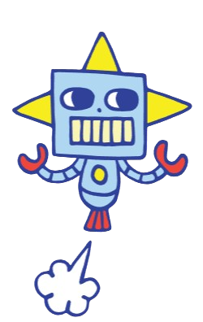
Robotica
Our application, Robotica is a multimodal interaction software to help users find their way around NYP. Users can ask for directions through an user-friendly and interactive touchscreen interface which can help guide users to their destination in the shortest or most accessible path. Our software also supports multiple languages that cater to a diverse audience. Visitors who have trouble understanding English can choose their language of choice. To aid elderlies in using our software, we will include a step-by-step instructional manual for proper use of the software. We aim to allow visitors or new students who come to Nanyang Polytechnic to have better access and more familiarisation with our school.

Slide 4
02
Our Problems

Slide 5
Our Problems
People who visit NYP are unable to find the location where they are supposed to go to. They may end up getting lost and be late for the event they must attend. Students who are new to NYP and are about to attend their first day of school and they unsure of where to go for their orientation/lessons. They worry they might be late if they do not plan their route properly.
01
02
People whose medium is not English may have trouble understanding our application and how it works as it is mainly in English
03
There may be bugs and errors throughout the software that can affect software performance

Slide 6
03
Our Solutions

Slide 7
Our Solutions
Have a robot, walk around the school, targeted to visitors from our school. Visitors can approach the robot to ask for directions then, our designed software will display parts of the school as options the visitor can choose to go. Once chosen, the route will be highlighted for the visitors to follow. The robot will be located near the entrances of the school – back, front, and sides.
01
02
Allow multiple key languages used in Singapore as options to ensure better comprehension if the app, especially for elderlies who cannot understand English fluently.
03
We will update our software regularly to get rid of any possible bugs so that our software is at its best performance.

Slide 8
04
Methodology

Slide 9
Methodology Our chosen method : Waterfall Approach
$20K
Requirements:
Has different language modes
Map with location
3. Can direct itself to requested location
4. System that answers questions about school
5. System voice command
6. Allows multiple lang. Options
7. Different type sizes
Specifications:
Ensure that it starts off with a welcome page (inviting users to use the robot) and has a start button near the bottom centre of the screen. It then asks for which location the user is trying to find.
10%
45K

Slide 10
Methodology Our chosen method : Waterfall Approach
$20K
Design:
Soft neutral colours for the app layout. Such as taupe, beige, light grey to make it look minimalistic, welcoming, and not too harsh on the eyes
Maintenance:
Will be tested out before allowing public to use. Will check up on it every other day. Feedback function will also be provided to relay if there are any faults in the app.
Coding:
Done on Scratch
Integration:
If application is successful, with minimal faults, it will be used for any visitors entering NYP for guidance and a better experience in our school.
45K
Testing:
Tested on Scratch

Slide 11
05
Apps We Used

Slide 12
Apps we made use of
Microsoft Project
Scratch
github

Slide 13
Thank You!

